Slide 1

Control in Human-Robot Interaction: Assignment 3
Urgent appendix removal training for non-medical personal in unstable environment
Group 3
Ditte Tangkau (5423767)
Fleur Kleene (5637104)
Ekaterina Karmanova

Slide 2

Motivation
Medical emergencies on offshore facilities are costly and risky (1) ~ 10% acute appendicitis (1)
Strategies to lower these costs (1):
Vaccinations
Improve screening
Improve treatment capabilities
High cognitive load – extreme conditions, inexperienced practitioner (level 3 stationed & level 4 on shore (2)), telemedicine (3)
Only improving the availability of instruments is not the solution
Notes:
https://journals.viamedica.pl/international_maritime_health/article/view/67868
https://academic.oup.com/occmed/article/59/5/298/1411270?view=extract
https://journals.viamedica.pl/international_maritime_health/article/view/43403
https://nl.pinterest.com/pin/97953360626069806/ – link source photo (4)

Slide 3
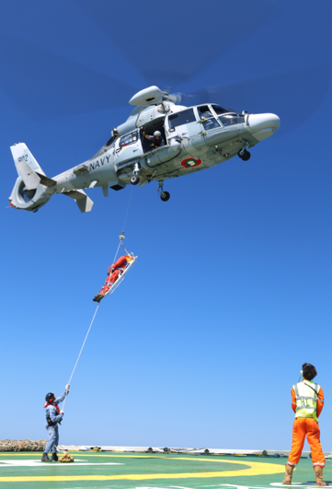
Existing solutions
Emergency evacuation via helicopter
Send a doctor to the facilities
Have a permanent medical crew to cope with emergency surgeries
Have a robotic device that can perform surgeries
BUT
Expensive logistics
Lack of trained personnel and doctors
Expensive and sophisticated in use equipment
Notes:
https://www.linkedin.com/pulse/offshore-medical-evacuation-kevin-a-green/ → link to source of the photo

Slide 4

Goal
To design and test a training environment where inexperienced medical practitioners can practice the surgery of acute appendicitis in the same conditions as they would experience on an offshore facility.
Training program should achieve:
Improvement in the performance to cut a straight line (by a hybrid controller)
Improve the accuracy for stitching (by an impedance controller)
Hypothesis:Practicing in conditions with perturbations will give a better performance and accuracy compared to practicing without one.

Slide 5
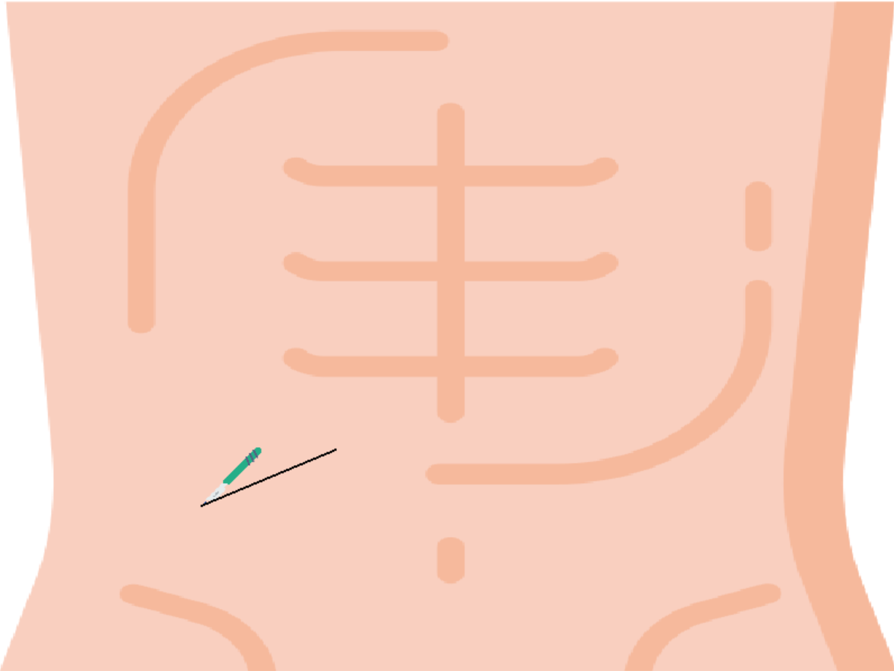
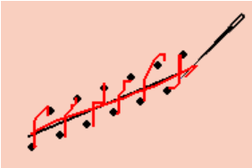
Method
Use the Haply and interactive 2D environment to train the personal perform two basic procedures in appendix removal surgery
Two tasks
1) Cutting a straight line is visualized by moving from one point to another
2) Accurate stitching is visualized by keeping the needle stable in position around points
Controller
Hybrid controller for task 1
Impedance controller for task 2
Task 1: Cutting
Task 2: Sewing

Slide 6



Experiments:
Two different conditions
C1 = with external perturbations
C2 = without external perturbations
Two different groups:
Group T1: x10 task C1 -> x10 task C2
Group T2: x10 task C2 -> x10 task C2
Hypothesis to evaluate: training teleoperated surgery in unstable environment leads to better performance rather than being trained in stable conditions.

Slide 7
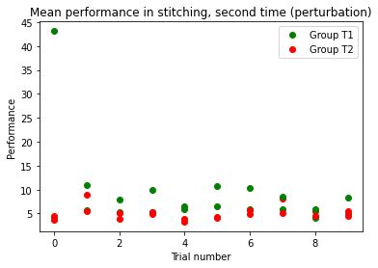
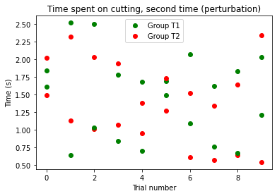
Experimental results: group T1

Slide 8
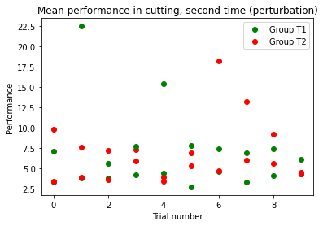
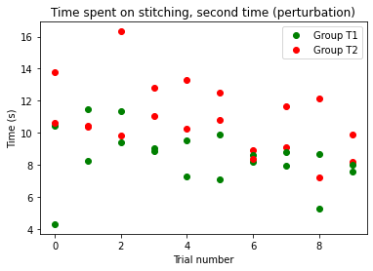
Experimental results: group T2

Slide 9
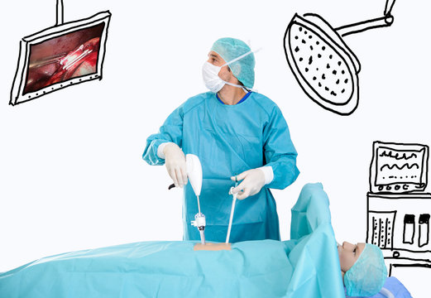
Conclusions
Hypothesis:Practicing in conditions with perturbations will give a better performance and accuracy compared to practicing without one.
Results: Group T2 performed the cutting task faster than group T1. The accuracy in the cutting task was similar.
Both groups performed the stitching task with similar speed. Group T2 had a higher performance score.
Discussion: More test-subjects would provide more accurate results.
Conclusion: Practicing in conditions with perturbations appears to slightly improve the time spent on cutting and the accuracy of stitching

